Slide 1
Apache PIG
-Arun P N

Slide 2
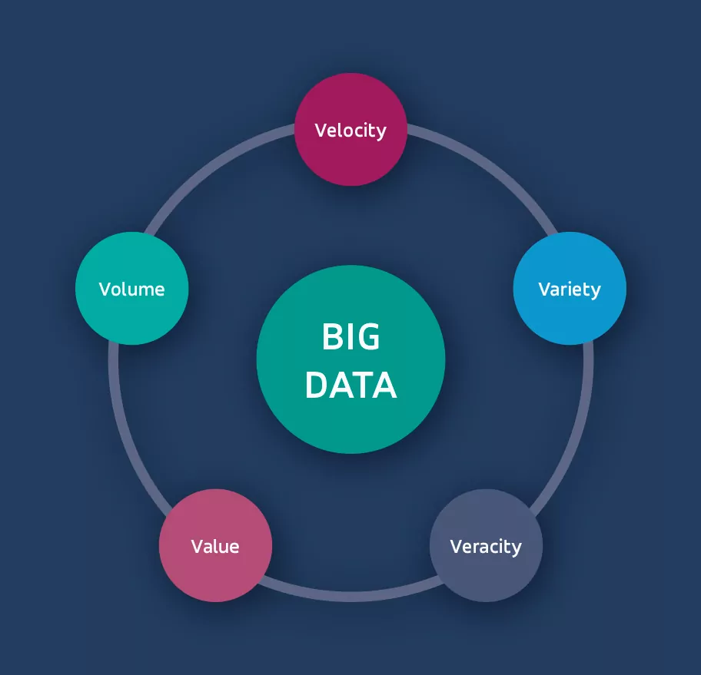
Overview of Big data analytics
Big Data means very large and complex data sets.
It comes from sources like social media, sensors, and apps.
Analytics helps find patterns and useful information from this data.
Businesses use it to make smart decisions and improve services.
Tools like Hadoop, Pig, and Hive help handle big data.
Notes:
Key Characteristics of Big Data:
Volume: Refers to the enormous size of the data sets.
Velocity: Describes the speed at which data is generated and processed.
Variety: Indicates the different formats and types of data, including structured, unstructured, and semi-structured data.
Veracity: Highlights the accuracy and trustworthiness of the data.
Value: Emphasizes the potential insights and business value derived from analyzing big data.
Examples of Big Data Sources:
Social media posts, images, and videos.
Sensor readings from various devices and machines.
GPS data from mobile devices.
Financial transaction records.
Customer relationship management (CRM) data.

Slide 3

INTRODUCTION TO APACHE PIG
A high-level data flow language and platform for analyzing large datasets.
It is particularly for the data stored in the Apache Hadoop File System (HDFS).
It simplifies the process of writing MapReduce jobs by providing a scripting language called Pig Latin.
Notes:
Apache Pig is a tool used to work with large amounts of data in Hadoop. It has its own simple language called Pig Latin, which is easy to learn. Instead of writing long Java programs, you can write short scripts to process data. Pig handles tasks like filtering, grouping, and joining data with ease. It’s especially useful when you need to analyze data quickly and efficiently.
Introducing Apache Pig
Apache Pig is a high-level platform for processing large datasets
Uses a scripting language called Pig Latin
Designed to simplify MapReduce programming on Hadoop
Ideal for ETL tasks, data transformation, and analysis
Developed by Yahoo! and runs on the Hadoop ecosystem
Can process both structured and semi-structured data
Great for data engineers who prefer scripts over Java

Slide 4
WHY USE PIG?
Pig makes working with big data much easier and faster.
Its scripts are much shorter than traditional MapReduce programs.
You don’t need deep programming skills—just focus on what data you need.
It’s flexible and works well with both structured and unstructured data.
Perfect for tasks like cleaning, transforming, and analyzing data at scale.

Slide 5
PIG IN HADOOP ECOSYSTEM
Pig is a high-level scripting language for Hadoop
Translates Pig Latin scripts into MapReduce jobs automatically
Simplifies writing complex data transformations without Java coding
Works on top of Hadoop Distributed File System (HDFS)
Supports large-scale data processing and batch analytics
Integrates with Hadoop ecosystem tools like HBase, Hive, and Hadoop YARN
Runs in local mode (small data) or MapReduce mode (large data clusters)
Notes:
Pig is a high-level scripting language for Hadoop
Translates Pig Latin scripts into MapReduce jobs automatically
Simplifies writing complex data transformations without Java coding
Works on top of Hadoop Distributed File System (HDFS)
Supports large-scale data processing and batch analytics
Integrates with Hadoop ecosystem tools like HBase, Hive, and Hadoop YARN
Runs in local mode (small data) or MapReduce mode (large data clusters)

Slide 6
PIG VS TRADITIONAL SQL AND MAP REDUCE
Pig vs SQL: Pig is more flexible—it can handle both structured and unstructured data, unlike SQL which works mainly with structured data.
Pig vs MapReduce: Pig scripts are much shorter and easier to write. With MapReduce, you write complex code in Java; with Pig, you just write a few simple lines.
Pig is great for developers who want fast results without deep programming.
Feature | SQL | MapReduce | Pig
Data Type | Structured | Any | Any
Coding Effort | Low | High | Low
Flexibility | Low | High | High
Learning Curve | Easy | Hard | Easy
Notes:
Pig vs SQL: Pig is more flexible—it can handle both structured and unstructured data, unlike SQL which works mainly with structured data.
Pig vs MapReduce: Pig scripts are much shorter and easier to write. With MapReduce, you write complex code in Java; with Pig, you just write a few simple lines.
Pig is great for developers who want fast results without deep programming.

Slide 7
PIG VS HIVE
Feature | Apache Pig | Apache Hive
Language | Pig Latin (procedural scripting) | HiveQL (SQL-like declarative)
Use Case | Data transformation & ETL | Data warehousing & querying
User Skill Level | Developers & data engineers | SQL users & analysts
Processing Model | Translates to MapReduce jobs | Translates to MapReduce or Tez
Schema Requirement | Schema on read (optional) | Schema on write (mandatory)
Query Optimization | Limited | Advanced query optimizer
Suitable for | Complex data flows, pipelines | Ad-hoc queries, BI reporting
Performance | Efficient for data pipelines | Optimized for interactive queries
Integration | Works well with custom scripts | Works well with BI tools

Slide 8
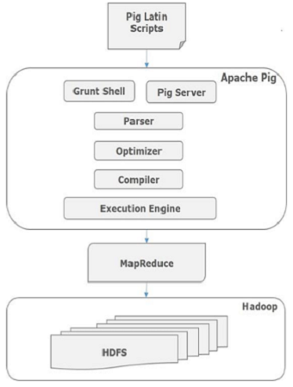
ARCHITECTURE OF APACHE PIG
Users write scripts using Pig Latin, a high-level language.
These scripts are sent to the Pig Engine, which converts them into MapReduce jobs.
The engine then runs these jobs on Hadoop (HDFS + MapReduce).
Pig handles all the complex processing in the background.
This makes it easy to focus on what to do with data, not how to do it.
Notes:
Users write scripts using Pig Latin, a high-level language.
These scripts are sent to the Pig Engine, which converts them into MapReduce jobs.
The engine then runs these jobs on Hadoop (HDFS + MapReduce).
Pig handles all the complex processing in the background.
This makes it easy to focus on what to do with data, not how to do it.
The Pig Architecture
Pig has two main components:
Pig Latin Scripts (user-written code)
Execution Engine (runs on Hadoop)
Scripts are parsed and converted into logical plans
Logical plans are then turned into physical plans
Physical plans are translated into MapReduce jobs
Pig uses Grunt Shell for interactive execution
Works with HDFS to read/write large datasets
Supports both local mode and MapReduce mode

Slide 9
PROPERTIES OF PIG
Procedural Language: Executes step-by-step, like a script
Lazy Evaluation: Commands are not executed until a result is requested
Extensibility: Supports User Defined Functions (UDFs) in Java, Python, etc.
Optimization: Pig automatically optimizes execution plans
Schema-on-read: Data doesn’t need to follow a fixed schema beforehand
Multi-language support: UDFs can be written in multiple languages
Handles any data: Works well with structured & unstructured data
Notes:
Properties of Pig
Procedural Language: Executes step-by-step, like a script
Lazy Evaluation: Commands are not executed until a result is requested
Extensibility: Supports User Defined Functions (UDFs) in Java, Python, etc.
Optimization: Pig automatically optimizes execution plans
Schema-on-read: Data doesn’t need to follow a fixed schema beforehand
Multi-language support: UDFs can be written in multiple languages
Handles any data: Works well with structured & unstructured data

Slide 10
BENFITS OF APACHE PIG
Simplifies complex data processing without writing Java
Uses Pig Latin, which is easy to learn and use
Supports parallel data processing via Hadoop
Great for ETL tasks, data cleaning, and transformations
Flexible – handles structured, semi-structured, and unstructured data
Enables rapid development and prototyping
Easily integrates with HDFS, HBase, Hive, and UDFs
Notes:
Benefits of Apache Pig
Simplifies complex data processing without writing Java
Uses Pig Latin, which is easy to learn and use
Supports parallel data processing via Hadoop
Great for ETL tasks, data cleaning, and transformations
Flexible – handles structured, semi-structured, and unstructured data
Enables rapid development and prototyping
Easily integrates with HDFS, HBase, Hive, and UDFs

Slide 11
PIG EXECUTION MODES: LOCAL VS MAPREDUCE
Local Mode Runs on a single machine using the local file system. Great for testing small scripts or learning Pig.
MapReduce Mode (or Hadoop Mode) Runs on a Hadoop cluster and processes large datasets. Uses HDFS and launches MapReduce jobs behind the scenes.
You can switch modes easily depending on the data size and setup.
Notes:
Pig Execution Modes
Local Mode Runs on a single machine using the local file system. Great for testing small scripts or learning Pig.
MapReduce Mode (or Hadoop Mode) Runs on a Hadoop cluster and processes large datasets. Uses HDFS and launches MapReduce jobs behind the scenes.
You can switch modes easily depending on the data size and setup.

Slide 12
PIG LATIN LANGUAGE BASICS
Pig Latin is a scripting language used in Apache Pig.
It works step-by-step—load data, process it, and store the results.
Each step is a command like: LOAD, FILTER, GROUP, FOREACH, DUMP.
Think of it like writing instructions in plain language for handling data.
It’s easy to learn and much shorter than Java code.
Notes:
Pig Latin is a scripting language used in Apache Pig.
It works step-by-step—load data, process it, and store the results.
Each step is a command like: LOAD, FILTER, GROUP, FOREACH, DUMP.
Think of it like writing instructions in plain language for handling data.
It’s easy to learn and much shorter than Java code.

Slide 13
DATA TYPES IN PIG
Pig supports simple types like int, long, float, double, chararray (string), and bytearray.
It also supports complex types that help handle structured data:
Tuple – like a row (e.g., (1, ‘ABC'))
Bag – a collection of tuples (like a table)
Map – key-value pairs (e.g., ['name’#’ABC'])
These types make it easier to work with nested and semi-structured data.
Notes:
Datatypes in Pig
Pig supports simple types like int, long, float, double, chararray (string), and bytearray.
It also supports complex types that help handle structured data:
Tuple – like a row (e.g., (1, 'Arun'))
Bag – a collection of tuples (like a table)
Map – key-value pairs (e.g., ['name'#'Arun'])
These types make it easier to work with nested and semi-structured data.

Slide 14
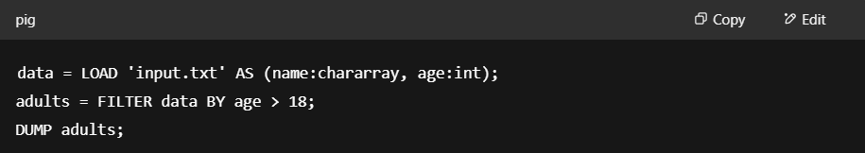
GETTING STARTED WITH PIG
Getting Started with Pig Latin
Pig Latin is a simple scripting language for data flows
Works with relations (similar to tables)
Common steps:
LOAD data from HDFS
FILTER, FOREACH, GROUP, JOIN, etc.
DUMP or STORE results
Example:
Notes:
Getting Started with Pig Latin
Pig Latin is a simple scripting language for data flows
Works with relations (similar to tables)
Common steps:
LOAD data from HDFS
FILTER, FOREACH, GROUP, JOIN, etc.
DUMP or STORE results
Example:
data = LOAD 'input.txt' AS (name:chararray, age:int);adults = FILTER data BY age > 18;DUMP adults; Case-insensitive and easy to understand

Slide 15
OPERATORS IN PIG
LOAD: Load data into a relation
STORE: Save results to HDFS
FILTER: Select tuples based on conditions
FOREACH...GENERATE: Transform data or create new fields
GROUP: Group data by a field for aggregation
JOIN: Combine data from two or more relations
ORDER: Sort data by specified fields
DISTINCT: Remove duplicate tuples
Operators can be chained to build complex data flows
Notes:
Working with Operators in Pig
LOAD: Load data into a relation
STORE: Save results to HDFS
FILTER: Select tuples based on conditions
FOREACH...GENERATE: Transform data or create new fields
GROUP: Group data by a field for aggregation
JOIN: Combine data from two or more relations
ORDER: Sort data by specified fields
DISTINCT: Remove duplicate tuples
Operators can be chained to build complex data flows

Slide 16
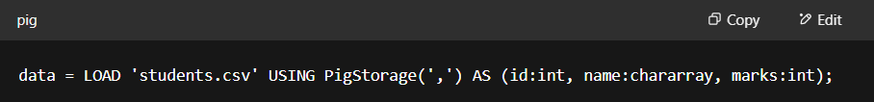
LOAD
The LOAD operator is used to read data into Pig from a file or HDFS.
You must specify the file path and optionally the schema (column names and types).
Pig doesn’t check the data when loading—it’s done lazily (when needed).
Example:
Notes:
The LOAD operator is used to read data into Pig from a file or HDFS.
You must specify the file path and optionally the schema (column names and types).
Pig doesn’t check the data when loading—it’s done lazily (when needed).

Slide 17
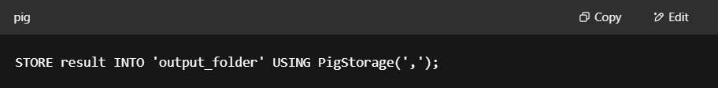
STORE
The STORE operator is used to save processed data to a file or HDFS.
You can choose the output format, like CSV, using a storage function.
It’s usually used at the end of a Pig script to write final results.
Example:
Notes:
The STORE operator is used to save processed data to a file or HDFS.
You can choose the output format, like CSV, using a storage function.
It’s usually used at the end of a Pig script to write final results.

Slide 18
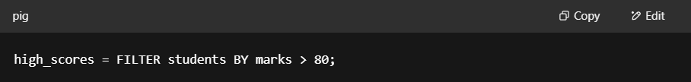
FILTER
The FILTER operator is used to select rows that match a condition.
It works like the WHERE clause in SQL.
Helps remove unwanted data before further processing.
Example:
Notes:
The FILTER operator is used to select rows that match a condition.
It works like the WHERE clause in SQL.
Helps remove unwanted data before further processing.

Slide 19
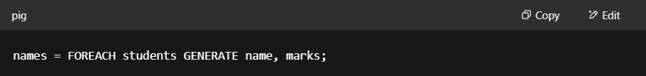
FOREACH
The FOREACH operator is used to process each row in a dataset.
You can use it to select specific columns or apply expressions.
Think of it like looping through rows to create a new output.
Example:
Notes:
The FOREACH operator is used to process each row in a dataset.
You can use it to select specific columns or apply expressions.
Think of it like looping through rows to create a new output.

Slide 20
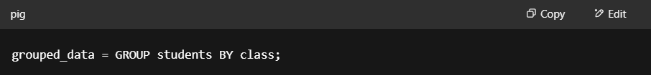
GROUP
The GROUP operator is used to group rows by a specific field.
It’s useful for doing operations like count, sum, or average on each group.
After grouping, each group is stored as a bag of records.
Example:
Notes:
The GROUP operator is used to group rows by a specific field.
It’s useful for doing operations like count, sum, or average on each group.
After grouping, each group is stored as a bag of records.
Example:

Slide 21
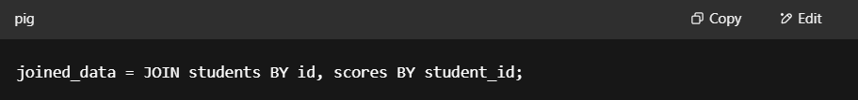
JOIN
The JOIN operator is used to combine two or more datasets based on a common field.
It works like SQL joins, helping bring related data together.
Very useful when data is split across multiple files or tables.
Example:
Notes:
The JOIN operator is used to combine two or more datasets based on a common field.
It works like SQL joins, helping bring related data together.
Very useful when data is split across multiple files or tables.
Example:

Slide 22
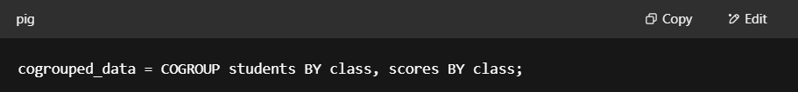
COGROUP
COGROUP groups two or more datasets by a common key but keeps their data separate.
Unlike JOIN, it keeps records from each dataset in separate bags within the group.
Useful when you want to analyze related data side-by-side without merging rows.
Example:
Notes:
COGROUP groups two or more datasets by a common key but keeps their data separate.
Unlike JOIN, it keeps records from each dataset in separate bags within the group.
Useful when you want to analyze related data side-by-side without merging rows.
Example:

Slide 23
BUILTIN FUNCTIONS
Pig provides many useful functions to perform common tasks quickly.
Aggregate functions like COUNT, SUM, AVG, MAX, MIN help summarize data.
String functions such as UPPER, LOWER, TRIM, CONCAT help clean and format text.
Date and time functions make it easy to work with timestamps.
Mathematical functions like ABS, FLOOR, CEIL, ROUND assist with numeric calculations.
Pig also supports type conversion functions to change data types.
You can combine these functions to build powerful data transformations.
If needed, Pig allows user-defined functions (UDFs) for custom operations.
Notes:
Built-in Functions in Pig
Pig provides many useful functions to perform common tasks quickly.
Aggregate functions like COUNT, SUM, AVG, MAX, MIN help summarize data.
String functions such as UPPER, LOWER, TRIM, CONCAT help clean and format text.
Date and time functions make it easy to work with timestamps.
Mathematical functions like ABS, FLOOR, CEIL, ROUND assist with numeric calculations.
Pig also supports type conversion functions to change data types.
You can combine these functions to build powerful data transformations.
If needed, Pig allows user-defined functions (UDFs) for custom operations.

Slide 24
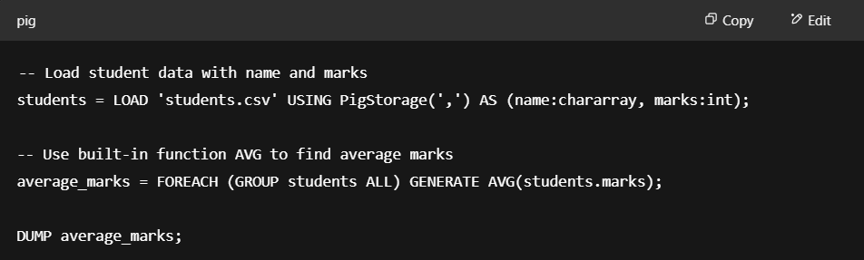
BUILTIN FUNCTIONS

Slide 25
USER DEFINED FUNCTIONS
UDFs help solve problems when built-in functions don’t fit your needs.
They let you add custom logic to your Pig scripts.
Common languages for writing UDFs are Java, Python (Jython), and JavaScript.
You write, compile (if needed), and register the UDF before using it.
UDFs can process one row at a time or work on groups of data.
They improve code reusability and keep scripts clean and manageable.
Using UDFs, you can implement complex calculations, data parsing, or special transformations.
Pig also supports UDF libraries created by the community, which you can reuse.
Writing UDFs requires basic programming skills but greatly increases Pig’s power.
Notes:
User-Defined Functions (UDFs) in Pig
UDFs help solve problems when built-in functions don’t fit your needs.
They let you add custom logic to your Pig scripts.
Common languages for writing UDFs are Java, Python (Jython), and JavaScript.
You write, compile (if needed), and register the UDF before using it.
UDFs can process one row at a time or work on groups of data.
They improve code reusability and keep scripts clean and manageable.
Using UDFs, you can implement complex calculations, data parsing, or special transformations.
Pig also supports UDF libraries created by the community, which you can reuse.
Writing UDFs requires basic programming skills but greatly increases Pig’s power.

Slide 26
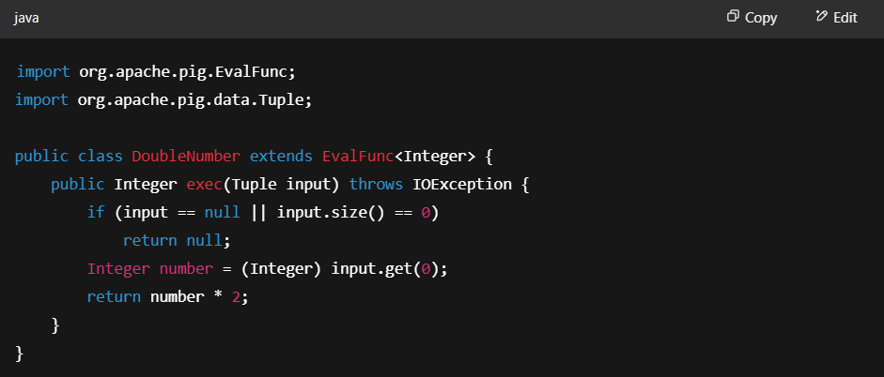
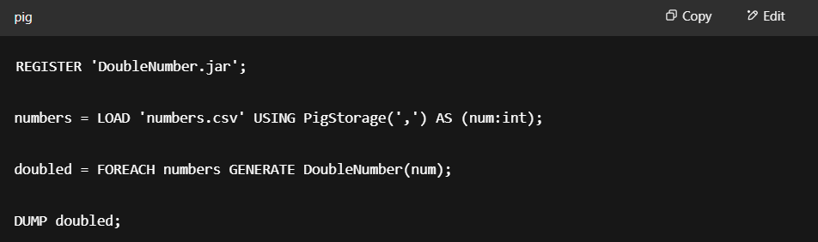
USER DEFINED FUNCTIONS

Slide 27
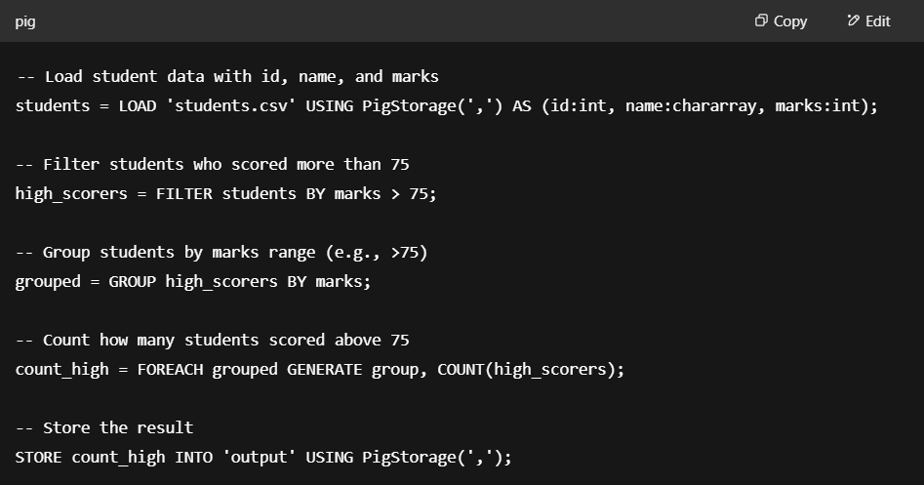
PIG SCRIPTS
Pig scripts are plain text files with a series of Pig Latin commands.
They automate data processing steps like loading, filtering, grouping, and storing data.
Scripts make it easy to reuse and share data workflows.
You can run scripts using the Pig command line or submit them to a Hadoop cluster.
Command to run a script: pig myscript.pig
Notes:
Pig scripts are plain text files with a series of Pig Latin commands.
They automate data processing steps like loading, filtering, grouping, and storing data.
Scripts make it easy to reuse and share data workflows.
You can run scripts using the Pig command line or submit them to a Hadoop cluster.
Example command to run a script:
bash
CopyEdit
pig myscript.pig

Slide 28
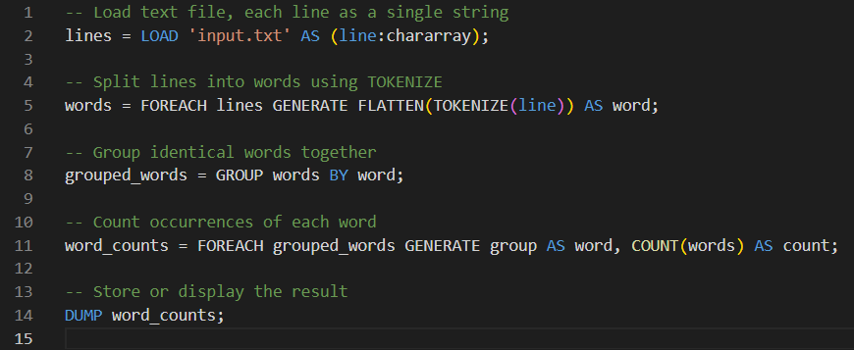
1. WORD COUNT WITH PIG
Steps:
Loads text lines
Breaks each line into words
Groups same words
Counts how many times each word appears
Notes:
-- Load text file, each line as a single string
lines = LOAD 'input.txt' AS (line:chararray);
Loads the input file named input.txt.
Each line of the file is treated as a single text string and stored in the alias lines.
chararray means each line is a string type.
-- Split lines into words using TOKENIZE
words = FOREACH lines GENERATE FLATTEN(TOKENIZE(line)) AS word;
FOREACH loops over each line in lines.
TOKENIZE(line) splits the line into a bag (collection) of words by whitespace.
FLATTEN converts the bag of words into individual rows.
Each word is assigned the alias word.
-- Group identical words together
grouped_words = GROUP words BY word;
Groups all rows in words by the actual word value.
All identical words are collected into groups to prepare for counting.
-- Count occurrences of each word
word_counts = FOREACH grouped_words GENERATE group AS word, COUNT(words) AS count;
For each group (each unique word), this line:
Takes the group key (group) which is the word itself and names it word.
Uses COUNT(words) to count how many times that word appeared.
This creates a dataset with each word and its count.
-- Display the word counts
DUMP word_counts;
DUMP prints the contents of word_counts to the console.
This shows the final word and their counts.

Slide 29
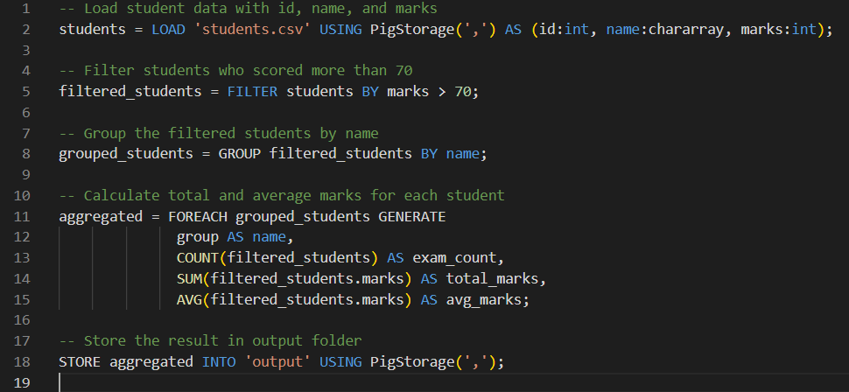
2. DATA FILTERATION AND AGGREAGRATION
Steps
Loads student data
Filters out students scoring ≤ 70
Groups data by student name
Calculates count, sum, and average of marks per student
Stores the aggregated results
Notes:
-- Load student data with id, name, and marks
students = LOAD 'students.csv' USING PigStorage(',') AS (id:int, name:chararray, marks:int);
Loads data from the file students.csv.
Each row has three fields: id (integer), name (string), and marks (integer).
Uses PigStorage(',') because the file is comma-separated.
-- Filter students who scored more than 70
filtered_students = FILTER students BY marks > 70;
Keeps only those rows where the marks field is greater than 70.
This filters out students with 70 or below marks.
-- Group the filtered students by name
grouped_students = GROUP filtered_students BY name;
Groups the filtered student records by the name field.
All entries with the same student name are put into one group.
-- Calculate total and average marks for each student
aggregated = FOREACH grouped_students GENERATE
group AS name,
COUNT(filtered_students) AS exam_count,
SUM(filtered_students.marks) AS total_marks,
AVG(filtered_students.marks) AS avg_marks;
For each group (student name), this generates:
name: The student’s name (group is the group key).
exam_count: Number of exam entries for that student (count of records).
total_marks: Sum of all marks for the student.
avg_marks: Average marks for the student.
-- Store the result in output folder
STORE aggregated INTO 'output' USING PigStorage(',’);
Saves the final aggregated results to an output folder named output.
Data is stored in CSV format (comma-separated).

Slide 30
DEBUGGING PIG SCRIPTS
Use DESCRIBE to check schema of a relation
Use ILLUSTRATE to view data flow with examples
Use DUMP to print results (only for small datasets)
Use EXPLAIN to see the execution plan
Test with small input files before running on big data
Use comments and Grunt shell for step-by-step testing
Notes:
Use DESCRIBE to check schema of a relation
Use ILLUSTRATE to view data flow with examples
Use DUMP to print results (only for small datasets)
Use EXPLAIN to see the execution plan
Test with small input files before running on big data
Use comments and Grunt shell for step-by-step testing

Slide 31
PERFORMANCE TIPS
Use LIMIT to test scripts on smaller data
Filter early to reduce data as soon as possible
Project only needed columns (avoid SELECT *)
Use built-in functions like COUNT, SUM with combiners
Use replicated joins for small datasets (JOIN optimization)
Avoid unnecessary GROUP BY operations
Store intermediate results to reuse and avoid re-computation
Combine multiple operations in a single step when possible
Notes:
Use LIMIT to test scripts on smaller data
Filter early to reduce data as soon as possible
Project only needed columns (avoid SELECT *)
Use built-in functions like COUNT, SUM with combiners
Use replicated joins for small datasets (JOIN optimization)
Avoid unnecessary GROUP BY operations
Store intermediate results to reuse and avoid re-computation
Combine multiple operations in a single step when possible

Slide 32
PIG LATIN BEST PRACTICES
Write modular scripts (break logic into steps)
Use meaningful aliases for better readability
Avoid SELECT * — project only required fields
Apply FILTER early to reduce data quickly
Reuse relations instead of repeating logic
Use DUMP only for small datasets
Add comments (--) to explain logic
Test scripts on small sample data before full run
Notes:
Write modular scripts (break logic into steps)
Use meaningful aliases for better readability
Avoid SELECT * — project only required fields
Apply FILTER early to reduce data quickly
Reuse relations instead of repeating logic
Use DUMP only for small datasets
Add comments (--) to explain logic
Test scripts on small sample data before full run

Slide 33
ERROR HANDLING IN PIG
Pig provides error messages to help debug scripts
Common errors: syntax errors, data type mismatches, missing files
Use ILLUSTRATE command to see how data flows through a script
Check log files in Hadoop for detailed error info
Use TRY and CATCH in UDFs to handle exceptions gracefully
Best practice: test scripts on small data before running large jobs
Use comments (-- or /* */) for clarity and easier debugging
Notes:
Error Handling in Pig
Pig provides error messages to help debug scripts
Common errors: syntax errors, data type mismatches, missing files
Use ILLUSTRATE command to see how data flows through a script
Check log files in Hadoop for detailed error info
Use TRY and CATCH in UDFs to handle exceptions gracefully
Best practice: test scripts on small data before running large jobs
Use comments (-- or /* */) for clarity and easier debugging

Slide 34
APPLICATIONS OF APACHE PIG
Application Area | Description
Data Cleaning | Fix missing values, remove duplicates
ETL Workflows | Extract, transform & load data
Log Processing | Analyze web and server logs
Clickstream Analysis | Track user activity for insights
Ad Targeting | Preprocess data for personalized ads
Data Aggregation | Summarize large datasets (sales, views, etc.)
Sentiment Analysis | Preprocess text data for opinion mining
Machine Learning Pipelines | Prepare large-scale training data
Social Media Analysis | Transform unstructured social data
Research & Prototyping | Quick proofs of concept without Java coding
Retail & E-commerce | Analyze transactions, customer behavior
Telecom Analytics | Process call records and usage patterns
Healthcare Analytics | Preprocess patient data for trends and insights
Notes:
Data Cleaning: Fix missing values, remove duplicates
ETL Workflows: Extract, transform & load into data warehouses
Log Processing: Analyze web/server logs for patterns
Clickstream Analysis: Track user activity for insights
Ad Targeting: Preprocess data for personalized ads
Data Aggregation: Summarize large volumes (sales, views, etc.)
Sentiment Analysis: Preprocess tweets, reviews for text mining
Machine Learning Pipelines: Prepare training data at scale
Social Media Analysis: Transform unstructured social data
Research & Prototyping: Quick POCs without writing Java MapReduce
Retail & E-commerce: Analyze transaction, customer, and inventory data
Telecom Analytics: Process call records, usage patterns
Healthcare Analytics: Preprocess patient data for trends and insights

Slide 35
Experiment 3
Implement the following operations using Pig Operators/Functions:
LOAD, DUMP, FOREACH, GROUP, DISTINCT, LIMIT, ORDER BY,
JOIN, UNION, SPLIT, SAMPLE, AVG, MAX, COUNT, TUPLE, MAP,
PIGGY BANK, PARAMETER SUBSTITUTION, DESCRIBE
Notes:
Implement the following operations using Pig Operators/Functions: LOAD, DUMP, FOREACH, GROUP, DISTINCT, LIMIT, ORDER BY, JOIN, UNION, SPLIT, SAMPLE, AVG, MAX, COUNT, TUPLE, MAP, PIGGY BANK, PARAMETER SUBSTITUTION, DESCRIBE
Write a PIG script to load and store “Student data”. (Student file contains Roll no, Name, Marks and GPA). a. Filter all the students who are having GPA>5. b. Display the name of all Students in Uppercase. c. Group tuples of students based on their GPA. d. Remove duplicate tuples of Student list. e. Display first three tuples from “student” relation. f. Display the names of students in ascending order. g. Join two relations namely Student and department (Rno, DeptNo, DeptName) based on the values contained in the roll no column. h. Merge content of two relations Student and department. i. Partition a relation based on the GPA’s acquired by students.

Slide 36
Experiment 3
Operator/Function | Purpose | Example
LOAD | Load data into a relation | LOAD 'data.txt';
DUMP | Display relation contents | DUMP students;
FOREACH | Process/transform each row | FOREACH students GENERATE name;
GROUP | Group data by key | GROUP students BY GPA;
DISTINCT | Remove duplicate tuples | DISTINCT students;
LIMIT | Get first N rows | LIMIT students 3;
ORDER BY | Sort relation | ORDER students BY name ASC;

Slide 37
Experiment 3
Operator/Function | Purpose | Example
JOIN | Join two relations | JOIN s BY id, d BY id;
UNION | Combine two relations | UNION s, d;
SPLIT | Divide relation by condition | SPLIT s INTO a IF cond, b IF !cond;
SAMPLE | Random subset of data | SAMPLE students 0.1;
AVG, MAX, COUNT | Aggregate functions | AVG(grouped.marks);
TUPLE / MAP | Data types used in Pig | ({a,b}), [‘key’#value]
PIGGY BANK / PARAMETER | Advanced use / param support | pig -param GPA=5 script.pig
DESCRIBE | Display schema of relation | DESCRIBE students;

Slide 38
Experiment 3
Write a PIG script to load and store “Student data”. (Student file contains Roll no, Name, Marks and GPA).
Filter all the students who are having GPA>5.
Display the name of all Students in Uppercase.
Group tuples of students based on their GPA.
Remove duplicate tuples of Student list.
Display first three tuples from “student” relation.
Display the names of students in ascending order.
Join two relations namely Student and department (Rno, DeptNo, DeptName) based on the values contained in the roll no column.
Merge content of two relations Student and department.
Partition a relation based on the GPA’s acquired by students.
Notes:
Write a PIG script to load and store “Student data”. (Student file contains Roll no, Name, Marks and GPA).
Filter all the students who are having GPA>5.
Display the name of all Students in Uppercase.
Group tuples of students based on their GPA.
Remove duplicate tuples of Student list.
Display first three tuples from “student” relation.
Display the names of students in ascending order.
Join two relations namely Student and department (Rno, DeptNo, DeptName) based on the values contained in the roll no column.
Merge content of two relations Student and department.
Partition a relation based on the GPA’s acquired by students.

Slide 39
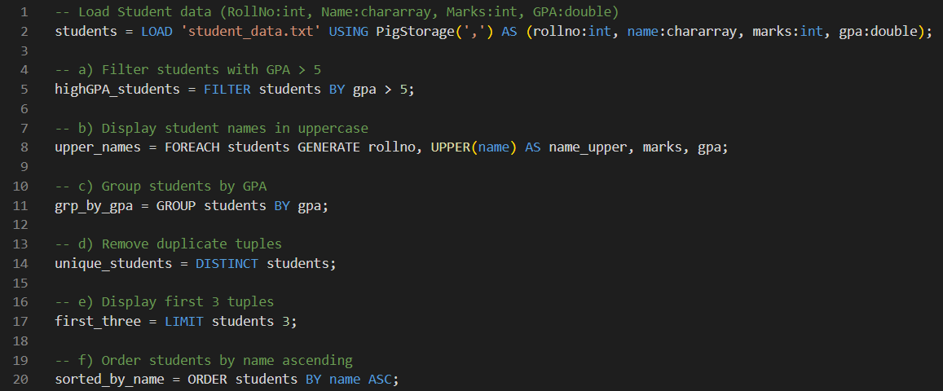
Experiment 3

Slide 40
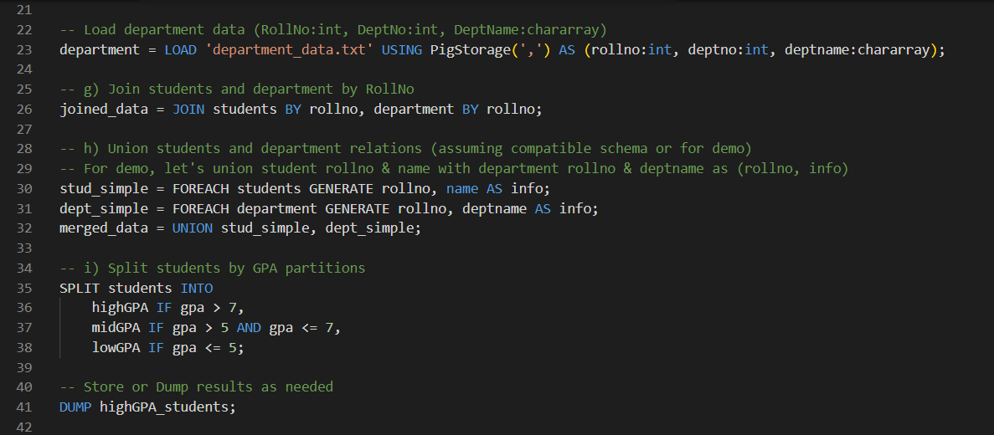
Experiment 3

Slide 41
SUMMARY
High-level scripting platform for processing big data on Hadoop
Uses Pig Latin language—simple and easy to learn
Supports key operators: LOAD, FILTER, GROUP, JOIN, FOREACH, STORE
Handles complex data types like tuples, bags, and maps
Provides built-in functions for math, string, and aggregation tasks
Allows custom User-Defined Functions (UDFs) for special needs
Runs in Local mode (single machine) or MapReduce mode (Hadoop cluster)
Scripts automate data workflows, making big data processing faster
Widely used for ETL tasks and data pipeline simplification
Examples: Word count and filtering with aggregation shown
Notes:
High-level scripting platform for processing big data on Hadoop
Uses Pig Latin language—simple and easy to learn
Supports key operators: LOAD, FILTER, GROUP, JOIN, FOREACH, STORE
Handles complex data types like tuples, bags, and maps
Provides built-in functions for math, string, and aggregation tasks
Allows custom User-Defined Functions (UDFs) for special needs
Runs in Local mode (single machine) or MapReduce mode (Hadoop cluster)
Scripts automate data workflows, making big data processing faster
Widely used for ETL tasks and data pipeline simplification
Examples: Word count and filtering with aggregation shown

Slide 42
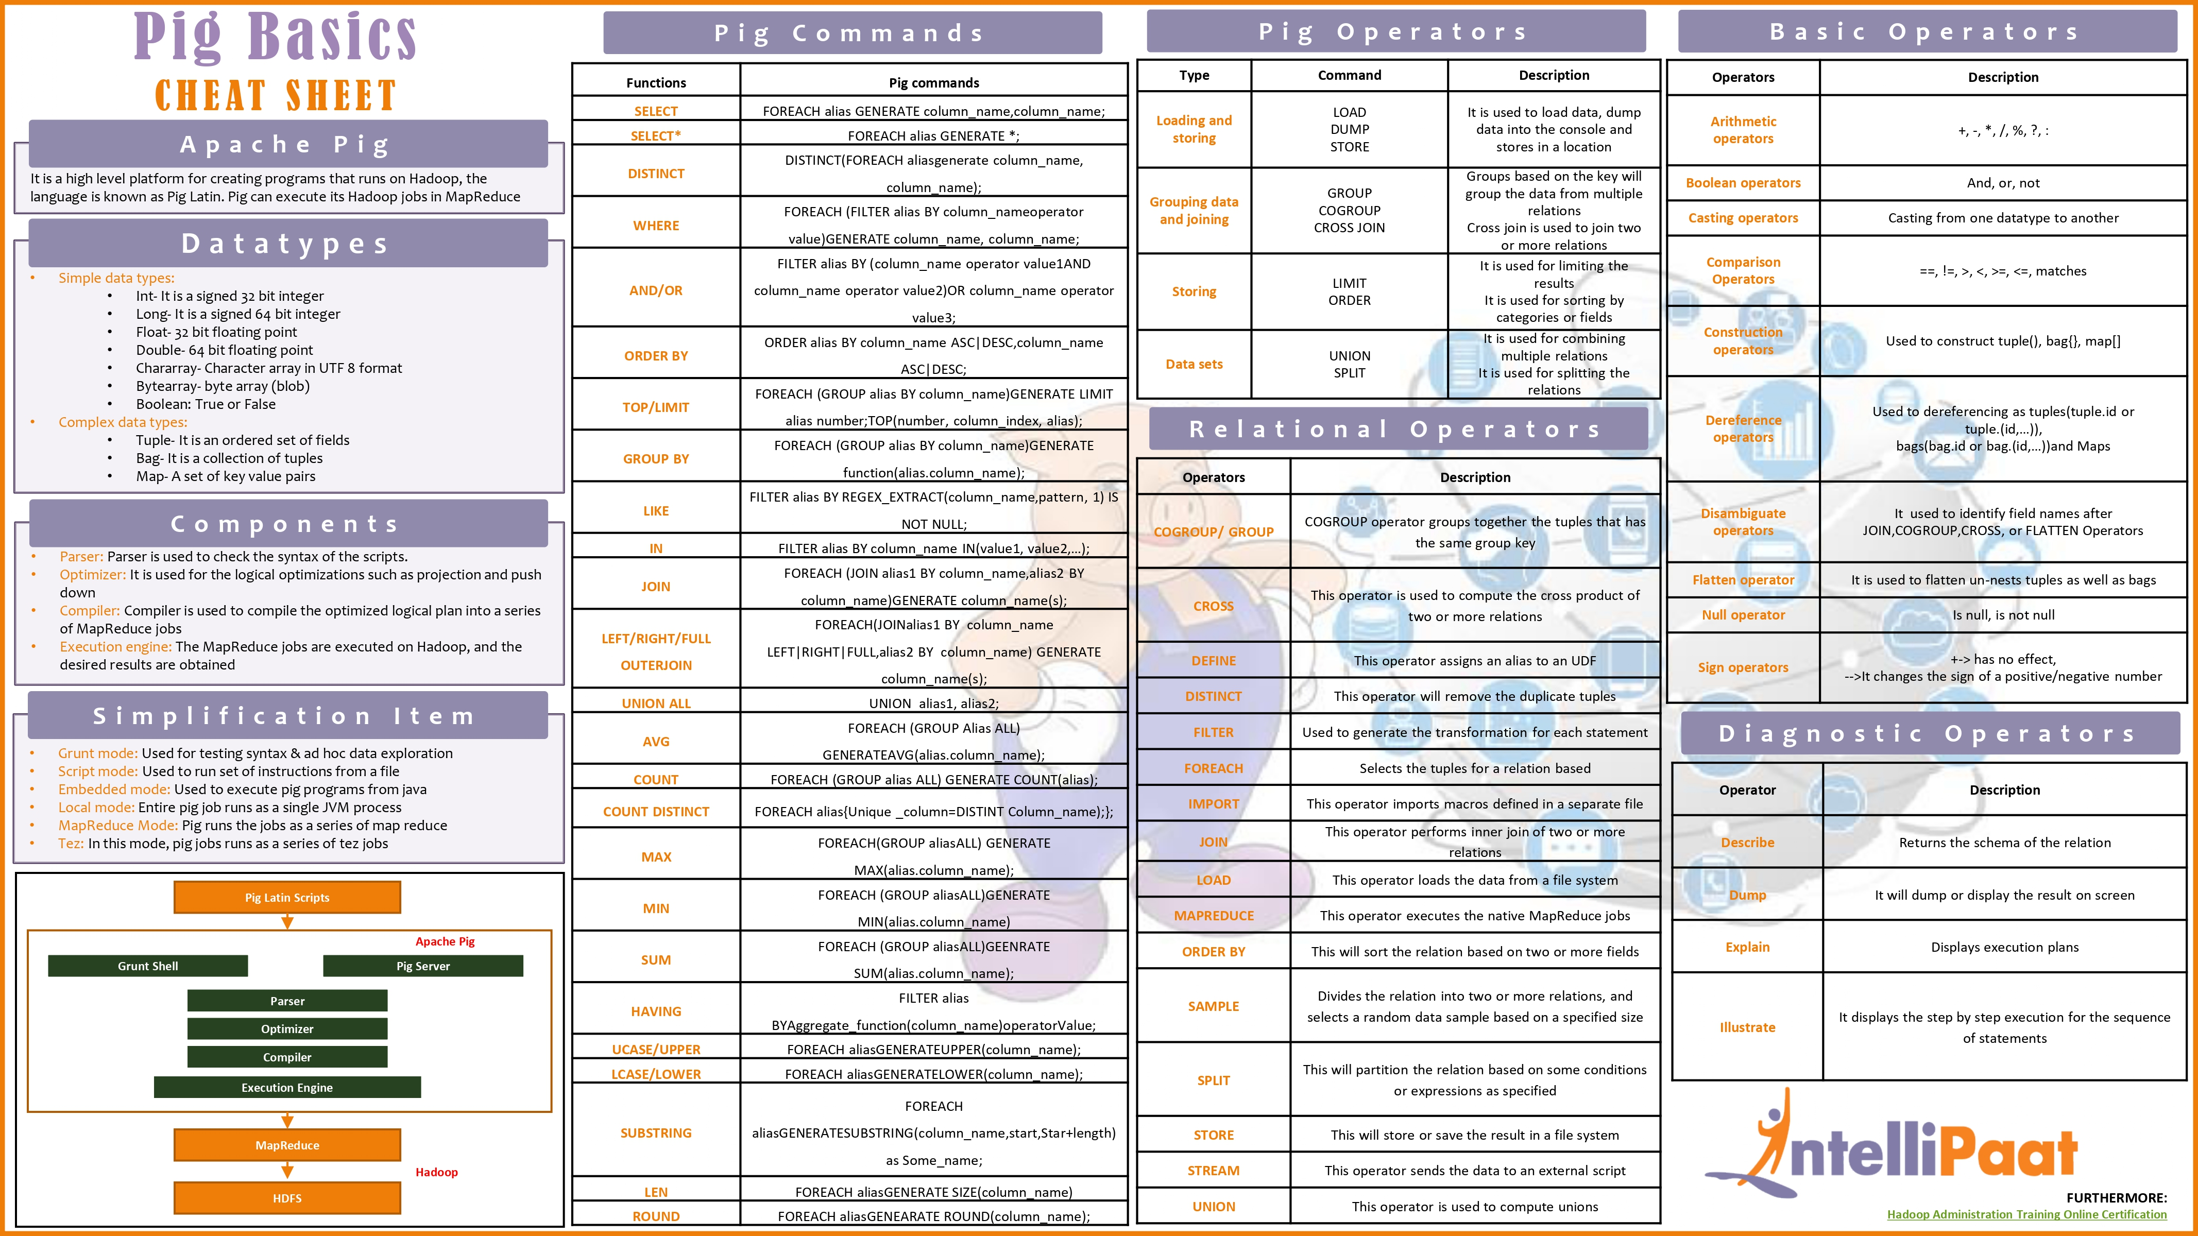
AT A GLANCE GUIDE

Slide 43
REFERENCES
Apache Pig Official Docs 🔗 pig.apache.org/docs/latest
TutorialsPoint – Pig Overview 🔗 tutorialspoint.com/apache_pig/index.htm
Pig Latin Basics 🔗 tutorialspoint.com/apache_pig/pig_latin_basics.htm
Running Pig Scripts 🔗 tutorialspoint.com/apache_pig/apache_pig_running_scripts.htm
Pig Installation Guide 🔗 tutorialspoint.com/apache_pig/apache_pig_installation.htm
Cheatsheet on PIG
🔗 qubole.com/wp-content/uploads/2014/01/Pig-Cheat-Sheet
GitHub link
🔗 github.com/pnarun/ApachePIG
Notes:
Apache Pig Official Docs 🔗 pig.apache.org/docs/latest
TutorialsPoint – Pig Overview 🔗 tutorialspoint.com/apache_pig/index.htm
Pig Latin Basics 🔗 tutorialspoint.com/apache_pig/pig_latin_basics.htm
Running Pig Scripts 🔗 tutorialspoint.com/apache_pig/apache_pig_running_scripts.htm
Pig Installation Guide 🔗 tutorialspoint.com/apache_pig/apache_pig_installation.htm
Cheatsheet on PIG
🔗 qubole.com/wp-content/uploads/2014/01/Pig-Cheat-Sheet
GitHub link
🔗 github.com/pnarun

Slide 44
ANY QUESTIONS?

Slide 45
Thank you
Arun P N
+91 866 039 7320
arunpn866@gmail.com
Linkedin.com/in/pnarun
Github.com/pnarun

